Slide 1
ASP.net Web Forms
Database-First Approach

Slide 2
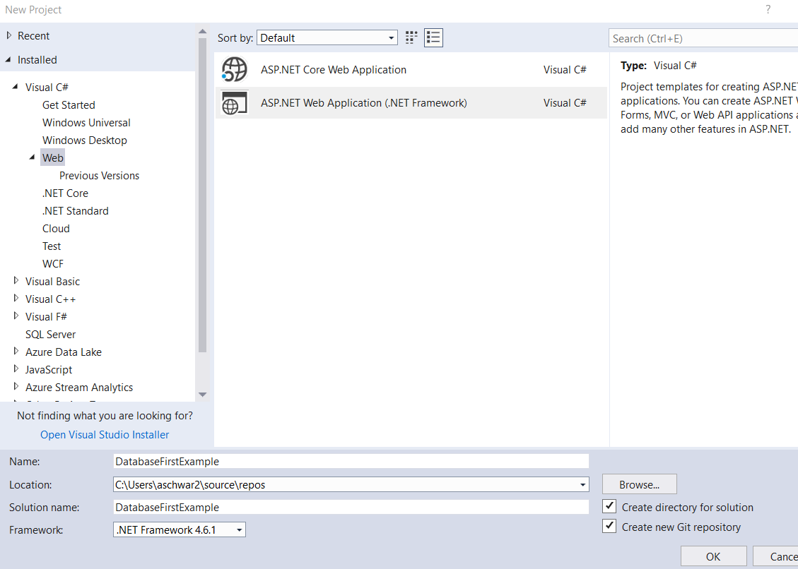
Create a Project in Visual Studio
Create a Project in Visual Studio

Slide 3
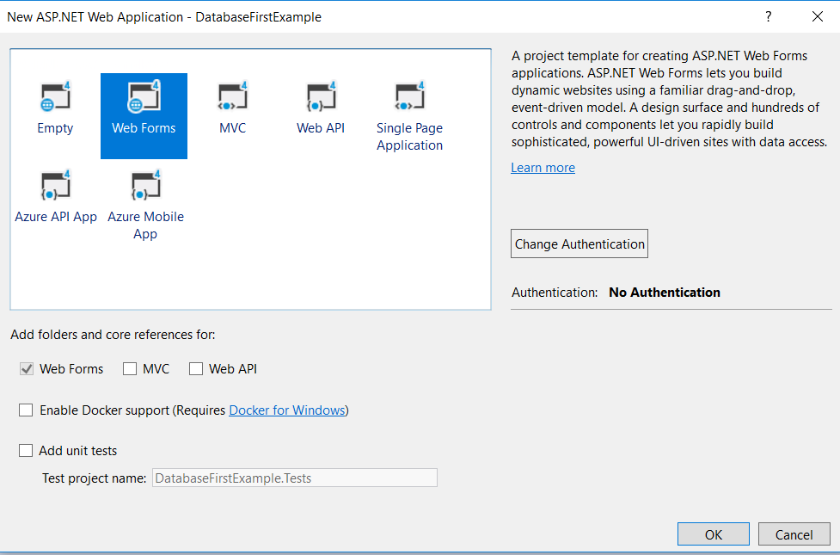
Creating a Project
Choose Web Forms
Click OK

Slide 4
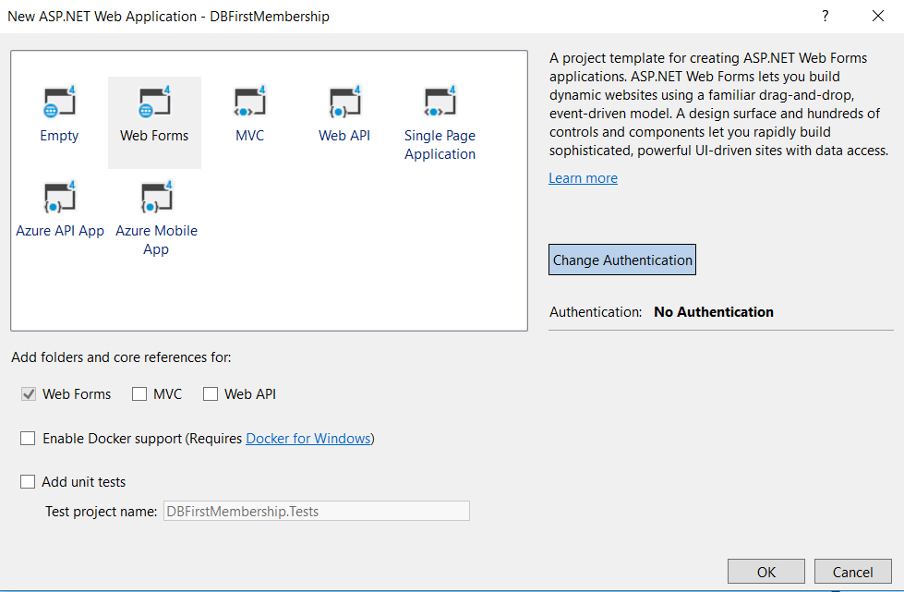
Creating a Project
Click the Change Authentication button

Slide 5
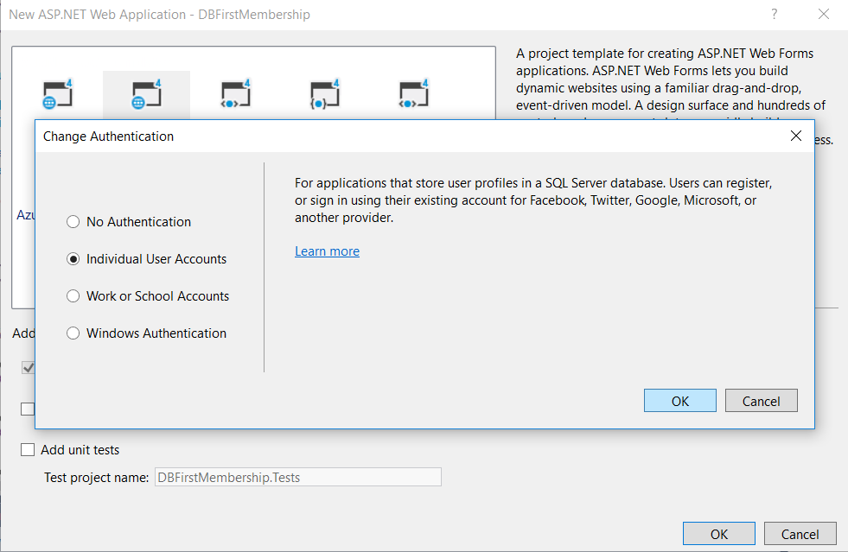

Slide 6
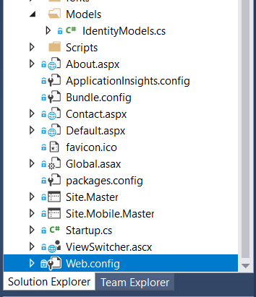
Web.config
The Web.config is a file that keeps a lot of the configuration information for your website.
One important setting in here is the connection string to the database.
This tells the website where to find the database.
Let’s open Web.config to take a look at this

Slide 7
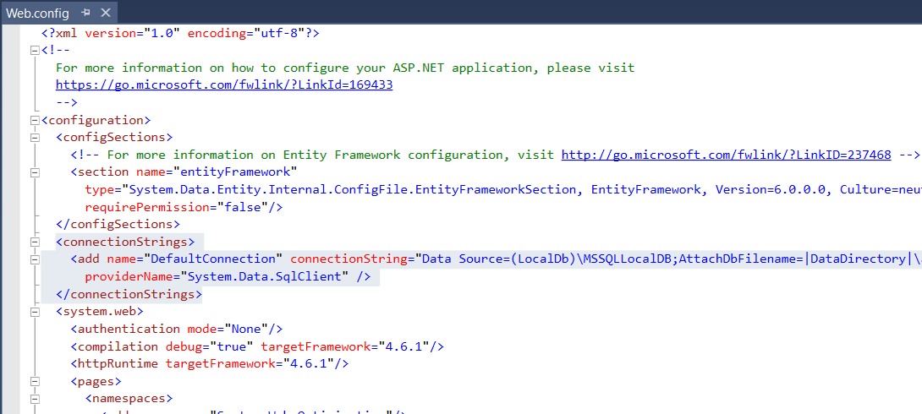
Database Connection String
Because we created our application to use Authentication, the application knows it requires a database.
Therefore, a connection string is inserted into web.config file.
Notice how it defaults to (LocalDB)\...
BEFORE we run the application and that database gets created, we are going to update this to tell it to use a different database.

Slide 8
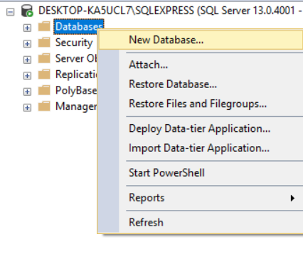
Creating a Database
Open MS SQL Server Management Studio and connect to your local DB instance
Right-click on the Databases folder and choose New Database

Slide 9
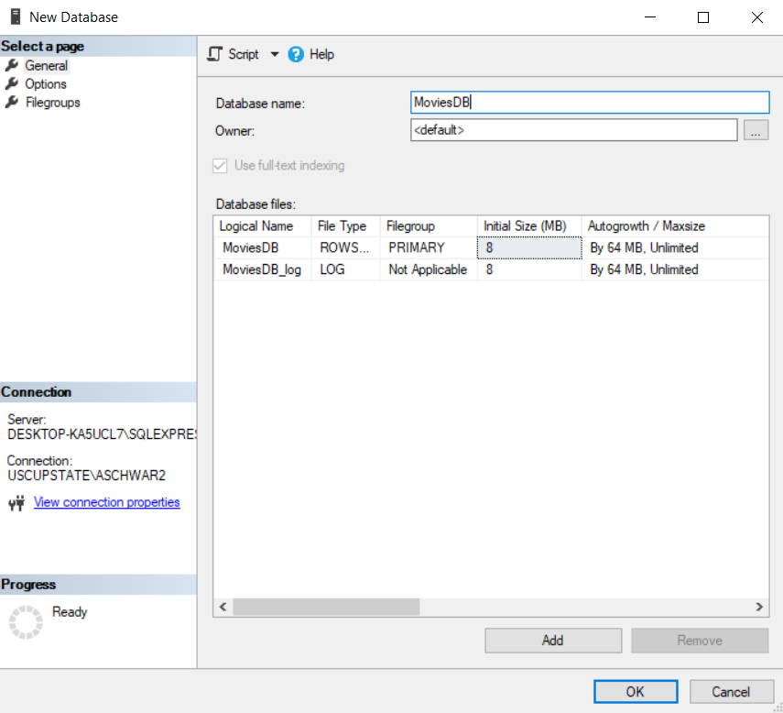
Creating a Database
Name it MoviesDB
Click OK.

Slide 10
Creating a Database
Open the create_movie_tables.sql file provided on Blackboard
Make sure the MoviesDB database is highlighted
Click Execute on the toolbar (or hit f5)

Slide 11
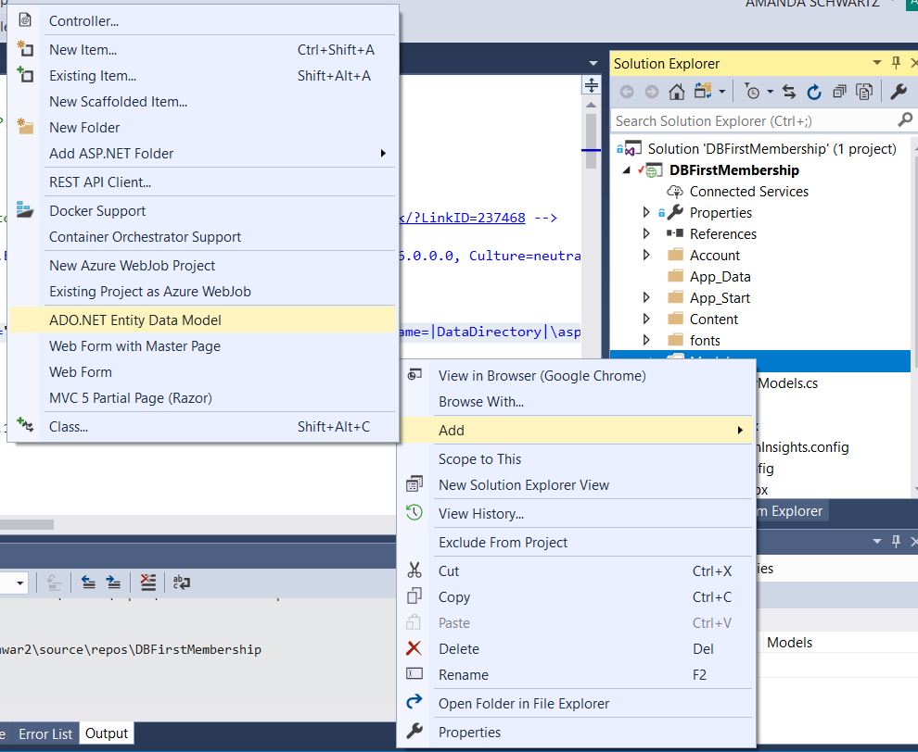
Adding the Data Model
Right-click on the Models folder in Solution Explorer
Choose Add -> ADO.NET Entity Data Model

Slide 12
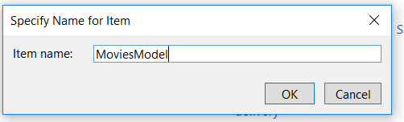
Adding the Data Model
Name the Model MoviesModel

Slide 13
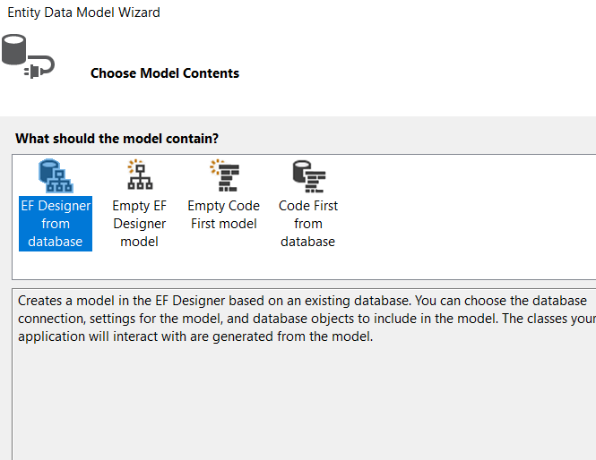
Adding the Data Model
Choose EF Designer from Database
Choose Next

Slide 14
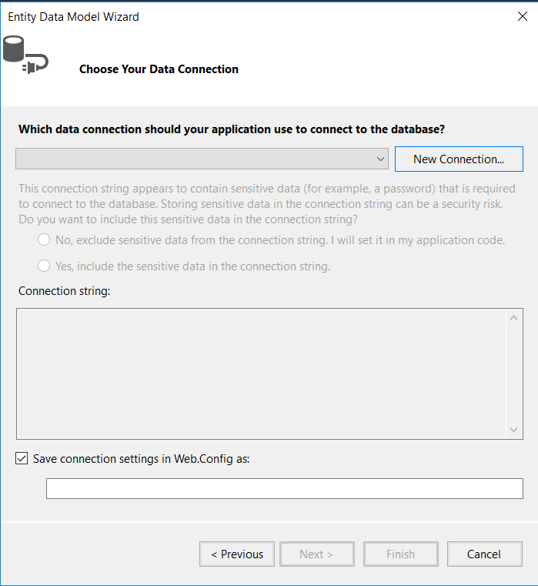
Adding the Data Model
Click on New Connection

Slide 15
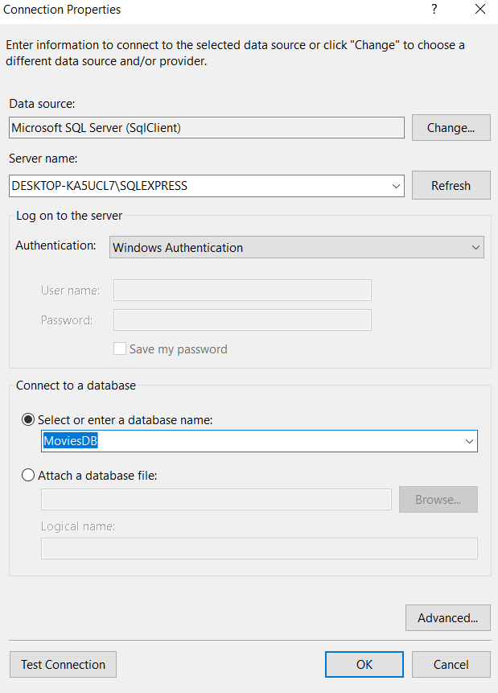
Adding a Data Model
Type the name of your SQL Server Express Instance
Note: This should match what you connected to in SQL Server Management Studio
Select MoviesDB from the Select or enter a database name dropdown.
Click OK.

Slide 16
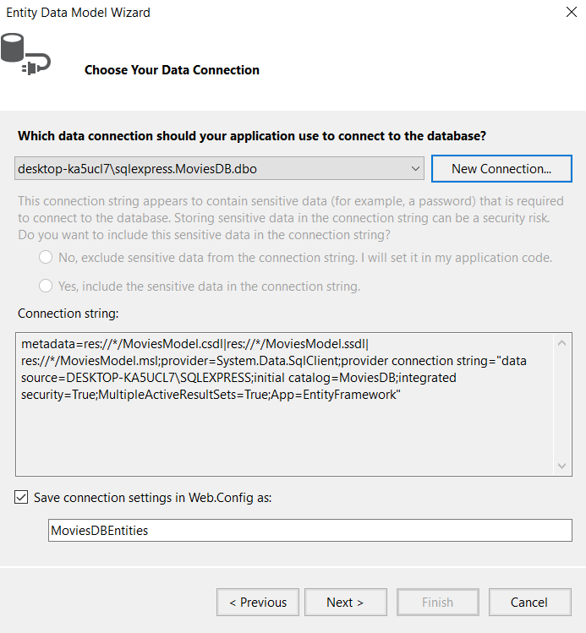
Adding a Data Model
Click Next.
Choose Entity Framework 6.x and click Next

Slide 17
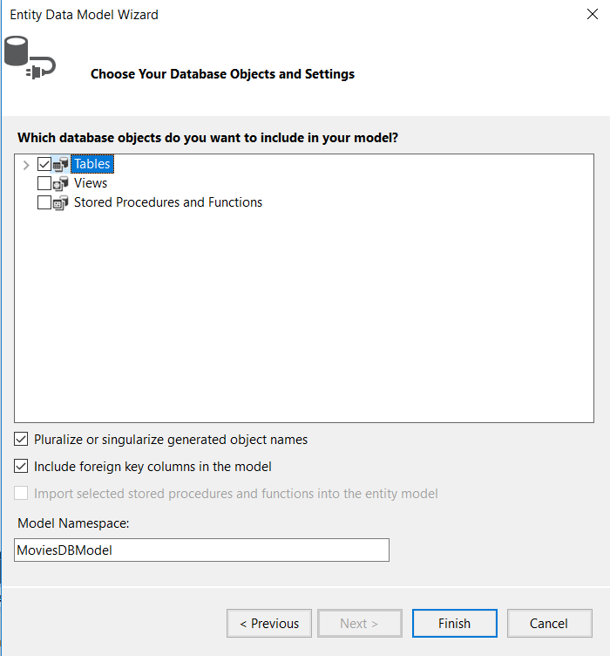
Adding a Data Model
Check the box next to Tables and click Finish.

Slide 18
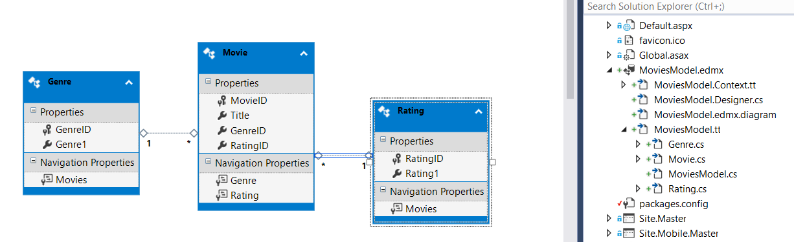
Adding a Data Model

Slide 19
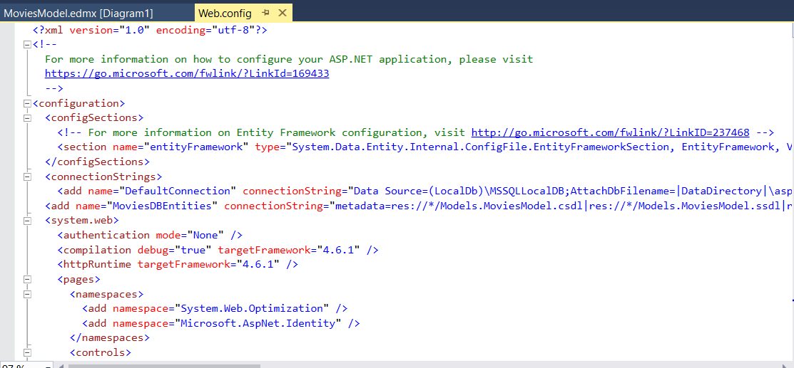
Web.config
Notice how after you add the model, another connection string appears in the Web.config file.

Slide 20
Modifying the Connection String
Let’s comment out the DefaultConnection connection string, make a copy and update to our new database
<add name="DefaultConnection" connectionString="Data Source=DESKTOP-KA5UCL7\SQLEXPRESS;initial catalog=MoviesDB;integrated security=True;MultipleActiveResultSets=True;App=EntityFramework" providerName="System.Data.SqlClient" />
<add name="MoviesDBEntities" connectionString="metadata=res://*/Models.MoviesModel.csdl|res://*/Models.MoviesModel.ssdl|res://*/Models.MoviesModel.msl;provider=System.Data.SqlClient;provider connection string=&quot;data source=DESKTOP-KA5UCL7\SQLEXPRESS;initial catalog=MoviesDB;integrated security=True;MultipleActiveResultSets=True;App=EntityFramework&quot;" providerName="System.Data.EntityClient" />

Slide 21
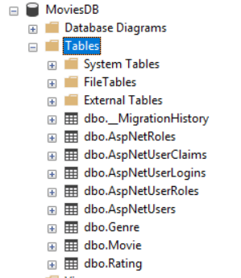
Testing the DB Connection
Run the application (Ctrl + F5) and register a new user.
Refresh the Tables in your Database through SQL Server Management Studio and see that the tables were created there.

Slide 22
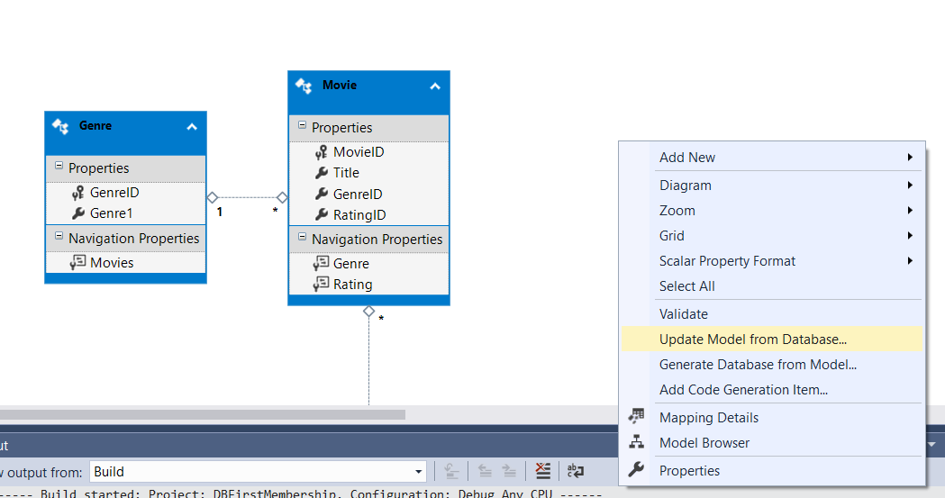
Updating the Model
Now that the database has changed, if we’d ever want to use any of those tables as classes in our project, we’d have to have them on the model.
Right-click on MoviesModel.edmx and Choose Update Model from Database.

Slide 23
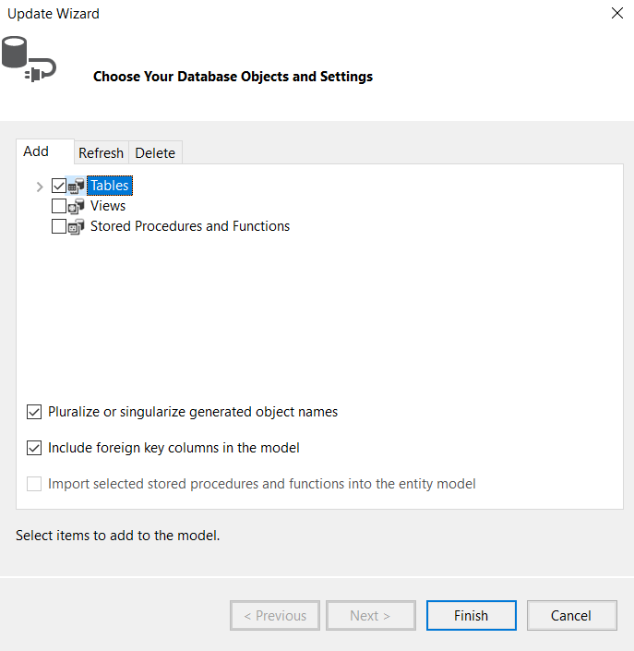
Updating the Model
Check the Box next to Tables and click Finish.
Note: any time you add, change, or delete tables in your database, you need to update the model.

Slide 24
You try
Create a page that will display all registered users to the site.

